Slide 1
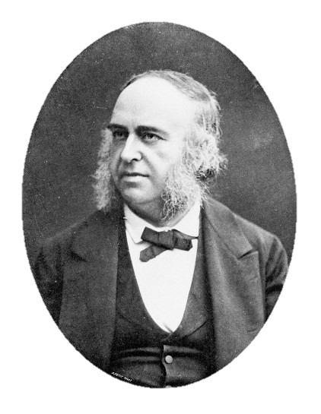
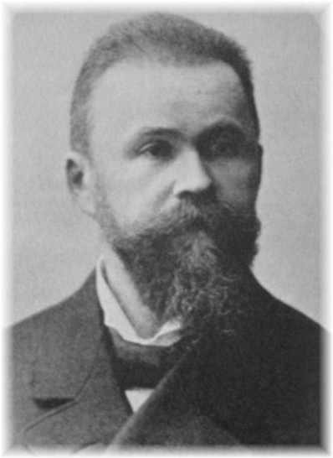
Neurological Disorders Lesson 1.5
How do the parts of my brain work together?

Slide 2
Do Now: How do we read The Cat in the Hat?

Slide 3
1. Sam wants (plans) to read The Cat in the Hat to his friend Pam
Reward Pathway
Prefrontal Cortex
Nucleus Accumbens
Ventral Tegmental Area

Slide 4
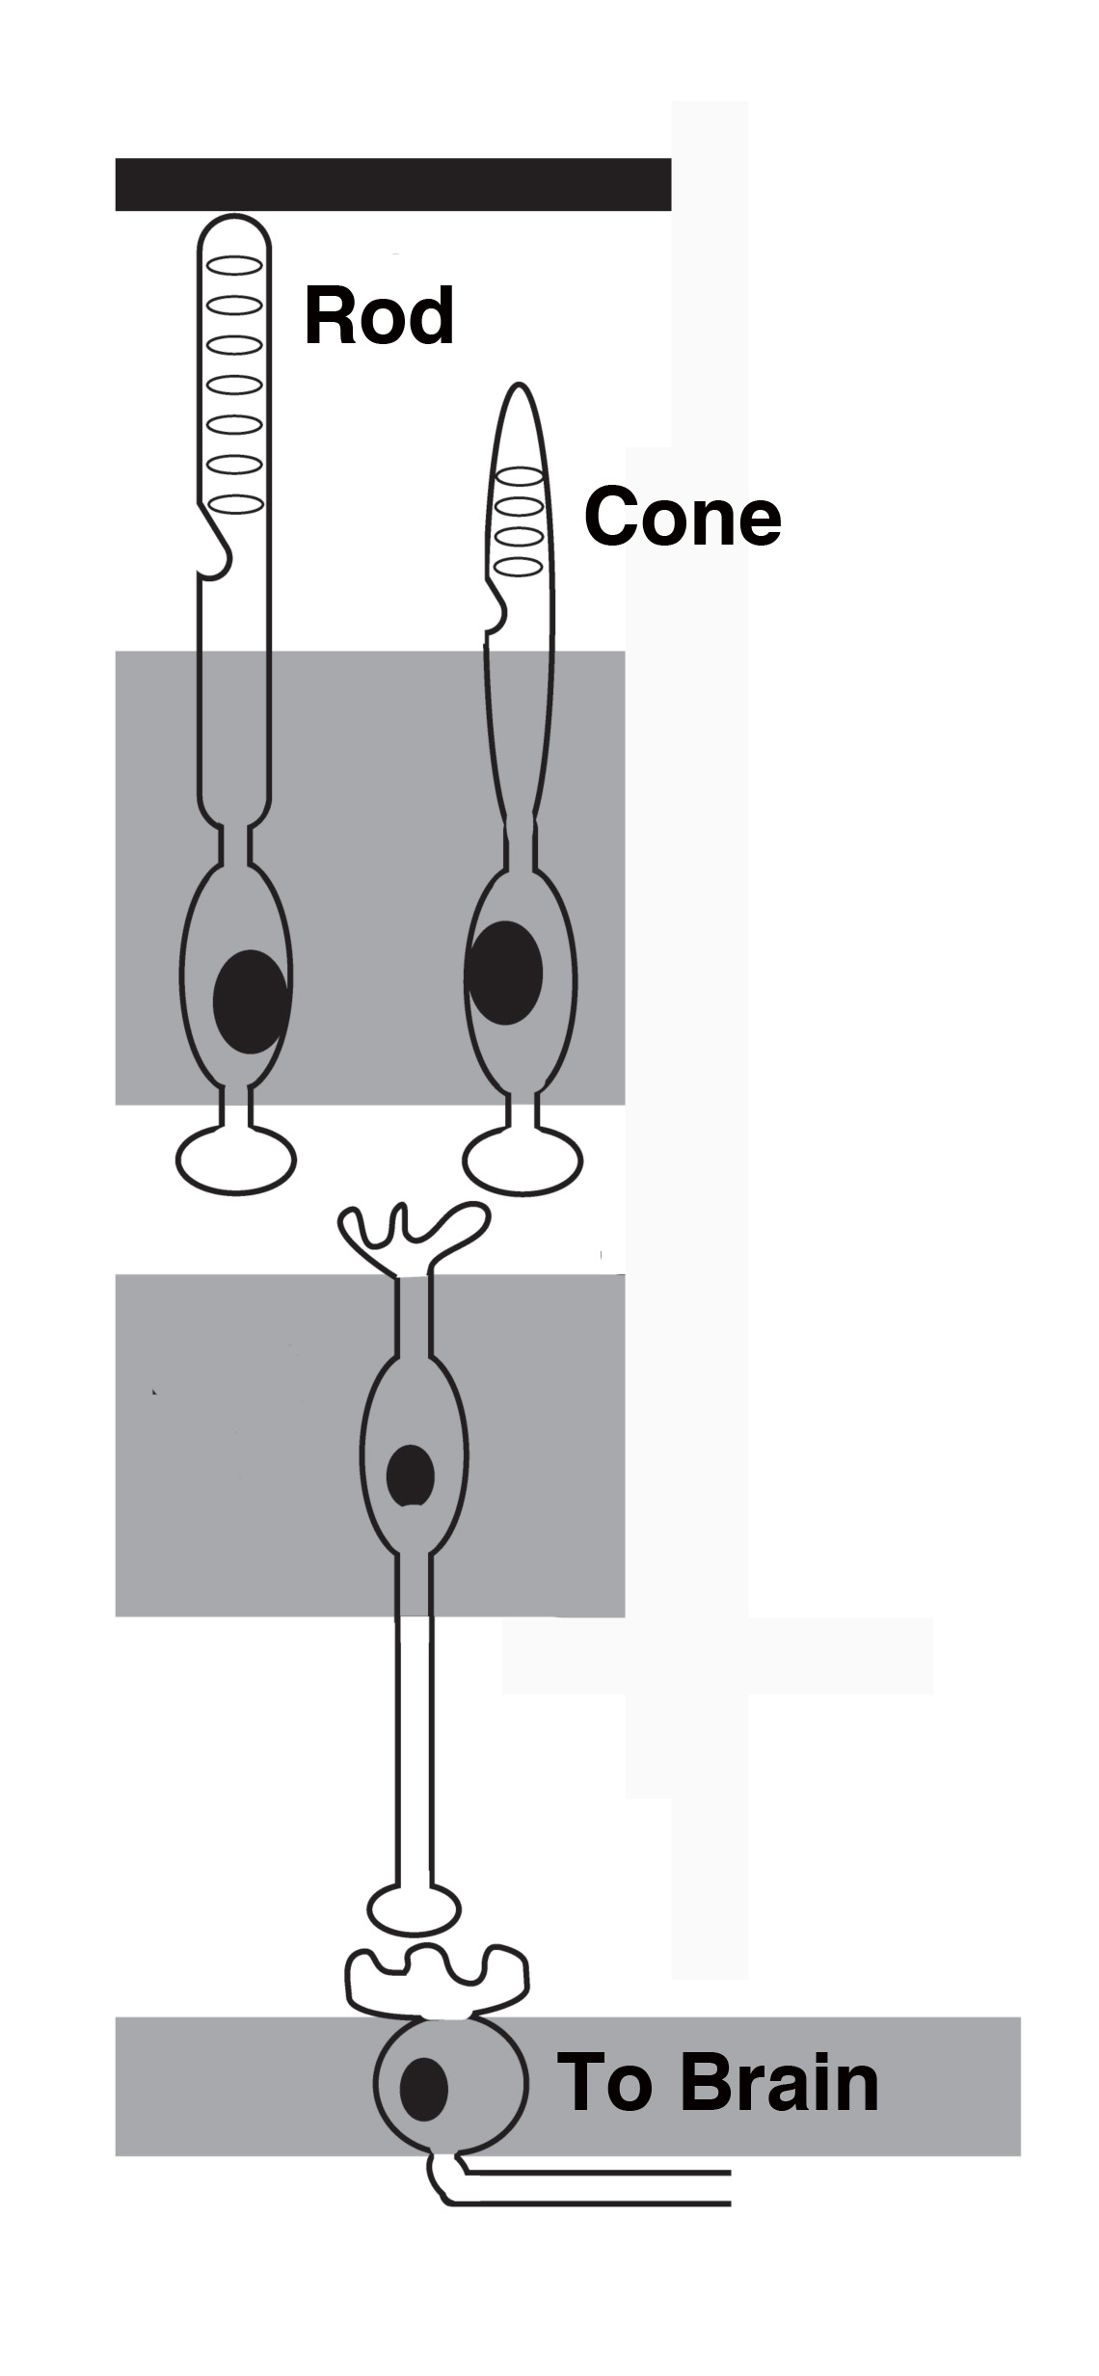
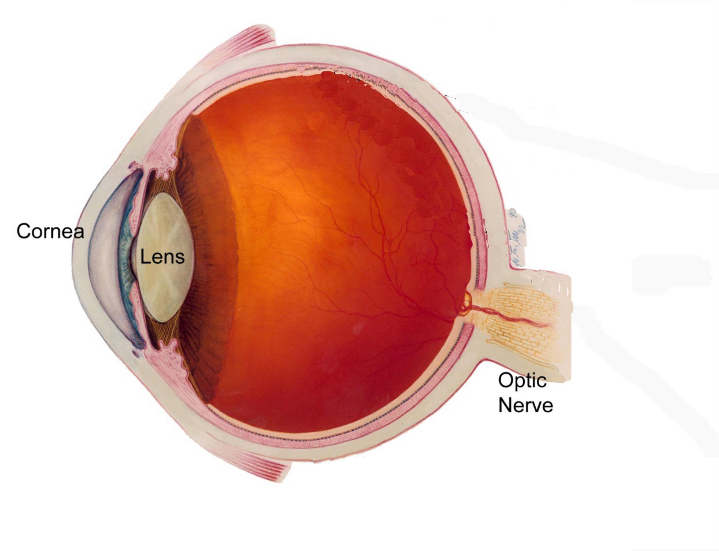
2. Sam puts on his reading glasses and looks at The Cat in the Hat.
The squiggles on the page stimulate rod and cone cells in his eye.
Eye
Retina
Dim light
Color/bright light

Slide 5
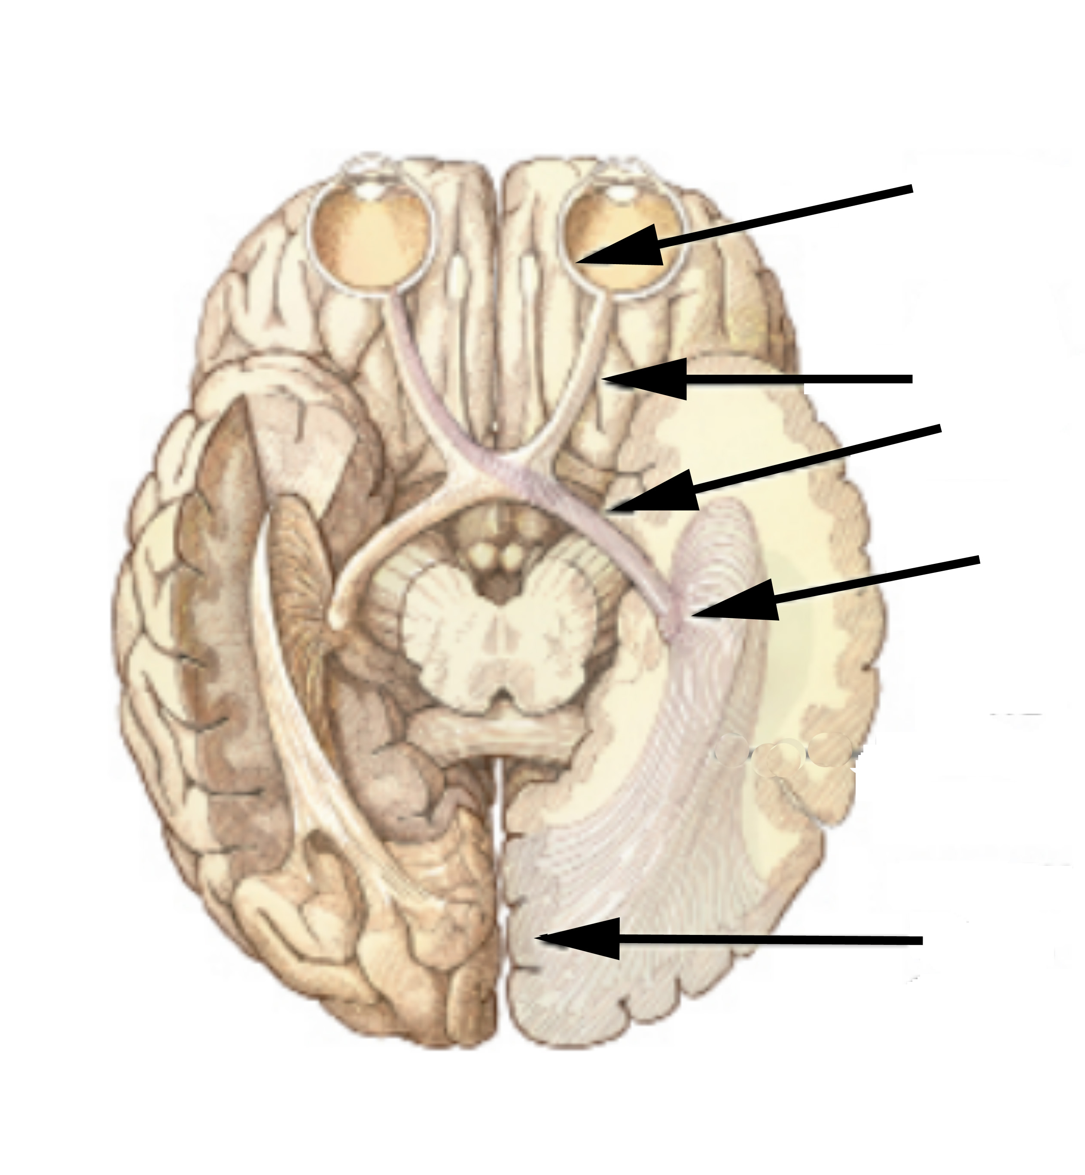
3. Sam’s optic nerve transmits information from his eye to his occipital lobe.
Retina
Optic nerve
Lateral geniculate
Occipital lobe

Slide 6
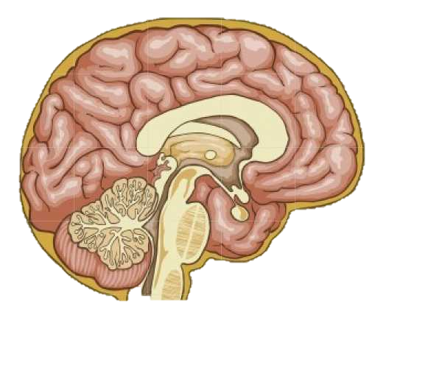
4. The information is transmitted from the occipital lobe to the thalamus.
Thalamus
Occipital lobe

Slide 7
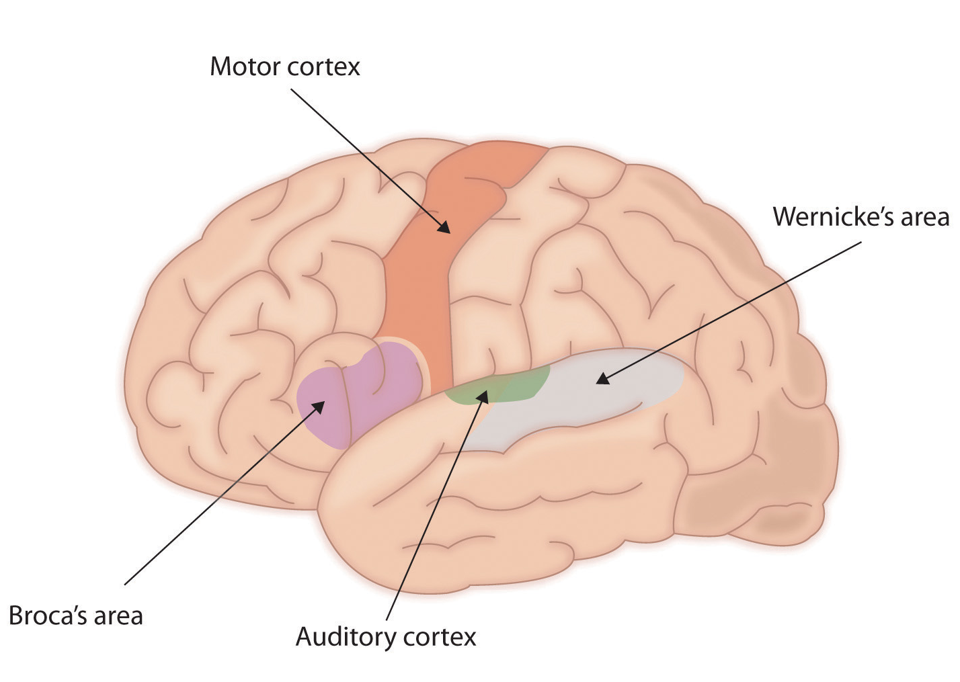
5. The information is transmitted from the thalamus to Wernicke’s area.
Wernicke’s area decodes the squiggles.
From Thalamus

Slide 8
6. The information is transmitted to Broca’s area.
Broca’s area creates the signals to produce speech.

Slide 9
7. The information is transmitted to the motor cortex.
Motor cortex produces signals for muscle movement.

Slide 10
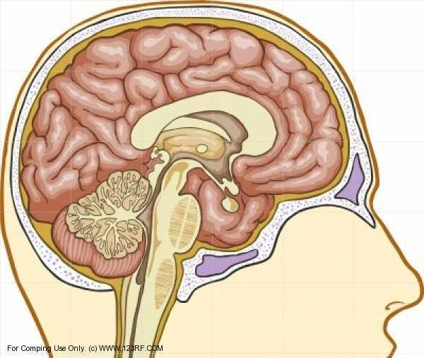
8. The signals from the motor cortex are sent to the brainstem and down the spinal cord.
Motor Cortex
Brainstem

Slide 11
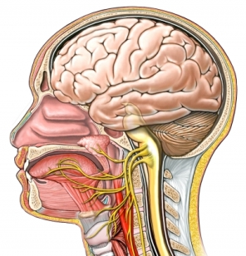
9. The motor neurons from the spinal cord connect to the muscles in the mouth and throat. Sam’s mouth produces the words he has read.
The Cat and the Hat
By Dr. Seuss
The sun did not shine.
It was too wet to play.
So we sat in the house
All that cold, cold, wet day.

Slide 12
What about Pam? What happens in her brain as she listens to the story?

Slide 13
She hears the spoken words. The acoustic nerve sends information to the auditory cortex in the temporal lobe.

Slide 14
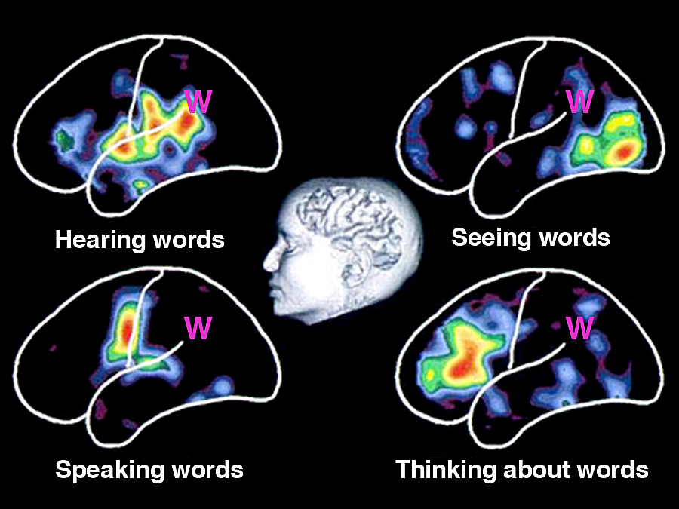
Many areas of the brain are required to process words

Slide 15
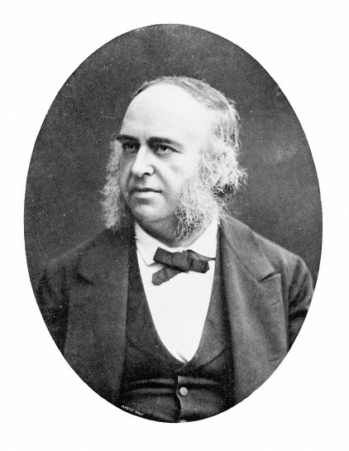
Broca’s Aphasia
Paul Broca
Described patients who could understand language, but could not speak.

Slide 16
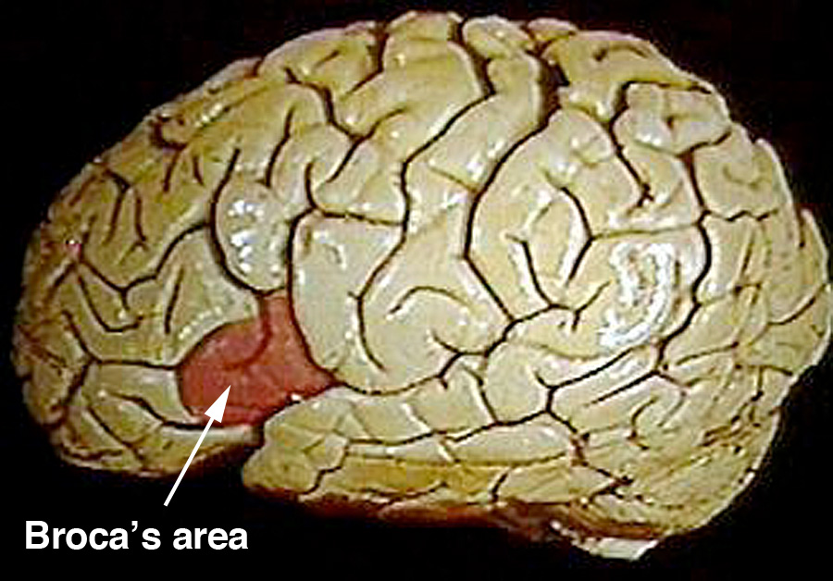
Broca’s Area
After Broca’s patients died, their brains were autopsied.
They all had damage in a region of their left frontal lobe.
This area is now called Broca’s area.

Slide 17
Wernicke’s Aphasia
Carl Wernicke
Described patients who could speak, but did not understand language.

Slide 18
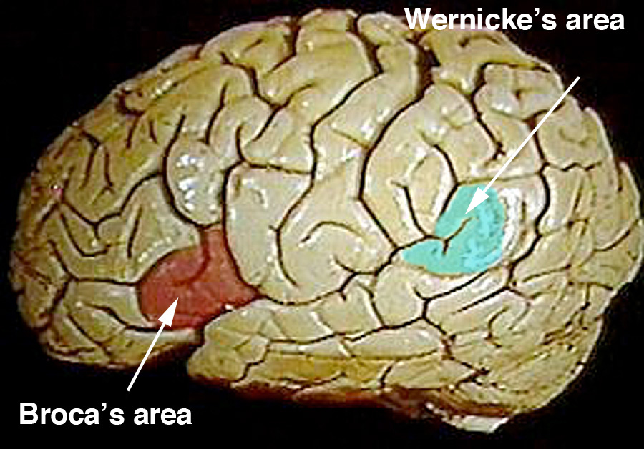
Wernicke’s Area
After Wernicke’s patients died, their brains were autopsied.
They all had damage in a region of their left temporal lobes.
This area is now called Wernicke’s area.

Slide 19
Conduction Aphasia
A third type of aphasia.
These patients can understand language and have no motor difficulties when they speak. However, they are unable to speak coherently because they have trouble finding words. They omit parts of words and use incorrect words.
Where are their brains damaged?

Slide 20
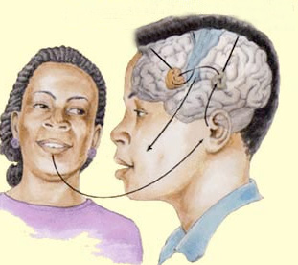
Conduction Aphasia
Motor cortex
Wernicke’s area
Broca’s area
3
X
2
1
4

Slide 21
What is aphasia?
What is Aphasia?
What is Broca's Aphasia?
Broca's Aphasia example
What is Wernicke's Aphasia?
Wernicke's Example
Conduction Aphasia example

Slide 22
Their Patients
Which kind of aphasia does each of these patients have?
Notes:
If you are having difficulties playing this video through the PowerPoint slide, you can access it online at: http://sites.tufts.edu/greatdiseases/modules/neurological-disease/multimedia-backup/
or
http://www.youtube.com/watch?v=1aplTvEQ6ew&feature=related

Slide 23
Their Patients
Which kind of aphasia does each of these patients have?
Notes:
If you are having difficulties playing this video through the PowerPoint slide, you can access it online at: http://sites.tufts.edu/greatdiseases/modules/neurological-disease/multimedia-backup/
or
http://www.youtube.com/watch?v=67HMx-TdAZI

